Slide 1
Valuation of Inventories as per Ind – AS 2

Slide 2
Learning Outcomes
Recognize the accounting treatment of inventories as per Ind – AS 2.
Apply the Ind – AS 2, in measuring the inventory costs of the businesses.

Slide 3
Ind – AS 2
IAS 2 sets out the accounting treatment for:
inventories, including the determination of cost,
the subsequent recognition of an expense and
any write-downs to net realisable value.

Slide 4
What are inventories ? (Ind AS 2)
Assets that are:
Held for sale in ordinary course of business.
In the process of production for sale
In the form of materials or supplies to be consumed in the production process or in the rendering of services.

Slide 5
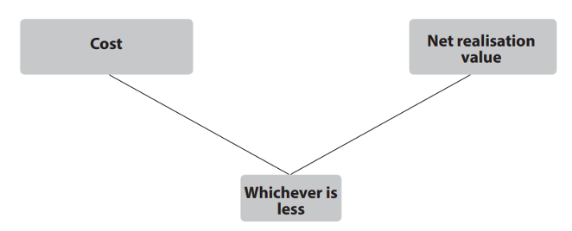
Measurement of Inventories

Slide 6
Measurement of Inventories – How to find the ‘cost’ of inventories
Cost of Inventories
1.)
Purchase Cost
2.)
Cost of Conversion
3.)
Cost incurred in bringing inventories to present location
+ Transport costs + Import duties - Discounts - Rebates
+ Direct labour + Fixed & variable production overheads
Notes:
Fixed & variable production overheads = depreciation of factory building and equipment, cost of factory management and conversion

Slide 7
Measurement of Inventory Cost
It does not include:
Abnormal waste (material, labor etc.)
Storage costs (but includes those necessary in production)
Administrative overheads
Selling and distribution costs
Finance costs

Slide 8
Poll – I
A company has incurred certain costs in relation to product ‘X’.
Raw Material Purchase cost $100
Freight paid $10
Discount on purchase $10
Labor engaged in production $50
Selling costs $20
The total inventory cost of product ‘X’ as per Ind – AS 2 is:
$190
$160
$150
$200
Notes:
c

Slide 9
Measurement of Inventories – How to find the ‘NRV’ of inventories
Estimated Selling Price
Estimated costs of completion
Net Realizable value (NRV)
Estimated costs to make the sale.

Slide 10
Poll – II
A manufacturing company has purchased a raw material costing $50 in the month of August 2020.
The goods were manufactured and were sold as finished products for $80 after additional $10 of labor costs were incurred for completion.
In such case, the NRV of the inventory will be:
$80
$10
$90
$70
Notes:
d

Slide 11
Application of ‘Prudence’ concept in Inventory Valuation
Inventory should be recorded at their original cost until they are sold.
No profit should be recognized until the profit is realized.
When a company realises that it may not be able to sell the inventory at a profit, then the valuation of inventory in such a case should be based on prudence concept of accounting.
This concept states that the loss must be recognized immediately.
Therefore if the net realizable value of inventory is lower than its original cost, then it should be valued at its net realizable value.
For example: if an inventory costs $100 and its NRV is only $70, then the inventory is recorded at the year end at $70.

Slide 12
Recognition of ‘Inventory’ in Financial Statements
Inventory valuation has two main effects:
Balance Sheet: current assets
Income Statement: Cost of Goods Sold
Beginning Inventory
Ending Inventory (Balance Sheet)
Cost of Goods Available for Sale (GAFS)
Not Sold
Sold
Goods Purchased during period
Cost of Goods Sold (Income Statement)

Slide 13
Poll – III
A manufacturing purchased inventory on 1 January 2019 for $ 300,000. On 31 December 2019, the inventory had an NRV of $ 350,000. During 2020, it sold the inventory for $ 320,000.
Based on the above, which of the following statements is ‘true’ with regard to inventory valuation as per Ind AS – 2?
The balance sheet reported the inventory at $ 300,000
When inventory was sold in year 2020, the company reported profit of $20,000 in its income statement
The balance sheet reported the inventory at $ 350,000
When inventory was sold, it reported loss of $50,000 in its income statement
Notes:
d

Slide 14
Recognition of Inventory in balance sheet and income statement
Income Statement
Balance Sheet
Sales
Minus
Inventory Purchases
Inventory Sales
Cost of Goods Sold
(an expense)
Merchandise
Inventory
Equals Gross Profit Minus
Selling Expenses and Administrative Expenses
Equals Net Income

Slide 15
Poll – IV
The following information relates to the inventory of a company:
Net realisable value $4000
Cost $4500
Replacement cost $3000
The amount of his inventory shown in the financial statements would be:
$4500
$4000
$4250
$3000

Slide 16
Determination of Cost for Service Providers
It is measured at the costs of the production.
Labour directly engaged in providing the service, including supervisory personnel, and attributable overheads are added in COP.
Labour and other costs relating to sales and general administrative personnel are not included.

Slide 17
Circumstances under which inventories are written down to net realisable value
In case of damaged inventories.
Inventory partially/ completely obsolete.

Slide 18
Disclosure as per Ind AS 2
Policies adopted in measuring inventories.
Value of inventories in different head of inventories like Raw material, WIP, Finished goods and stores and tools.
Written down value of inventories in current year.
Inventories pledged as security.

Slide 19
Ind AS 2 Vs. AS 2
Ind AS 2 | AS 2
Deals with the subsequent recognition of cost/carrying amount of inventories as an expense. | No such provision.
Provides explanation with regard to inventories of service providers. | AS 2 does not contain such an Explanation.
IND AS 2 requires more disclosures as compared to existing AS 2 | Less disclosure required as compared to IND AS 2
Use of same cost formula for inventory valuation | Not expressly mentioned to use the same cost formula for inventory valuation

Slide 20
Principal Inventory Valuation Methods
First – in – First Out Method
Weighted Average Method

Slide 21
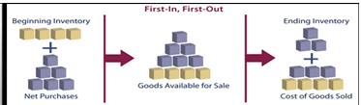
1.) First – in – First out Method (FIFO Method)
It assumes that inventory purchased or manufactured first is sold first and newer inventory remains unsold.

Slide 22
Recognition of Inventory using FIFO Method in Financial Statements
This method assumes that the first unit making its way into inventory–or the oldest inventory–is the sold first.
For example, a bakery produces 200 loaves of bread on Monday at a cost of $1 each, and 200 more on Tuesday at $1.25 each.
FIFO states that if the bakery sold 200 loaves on Wednesday, the COGS (on the income statement) is $1 per loaf because that was the cost of each of the first loaves in inventory.
The $1.25 loaves would be allocated to ending inventory (on the balance sheet).

Slide 23
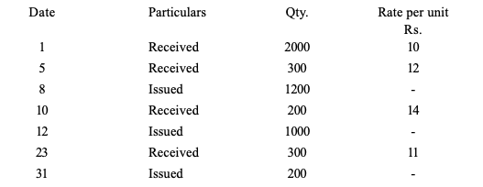
Practical problem - I
The following is a summary of the receipts and issues of materials in a factory during the month of April.
Prepare a statement showing the pricing of issues on the basis of FIFO Method

Slide 24
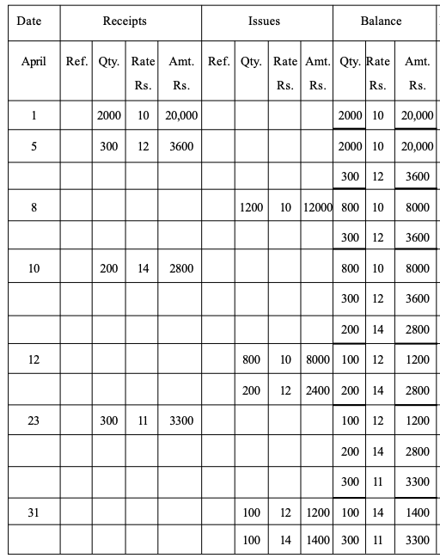
Solution

Slide 25
Poll – V
In case of rising prices, FIFO method of inventory valuation will:
provide lowest value of closing stock and profit
provide highest value of closing stock and profit
provide highest value of closing stock but lowest value of profit
provide highest value of profit but lowest value of closing stock
Notes:
b

Slide 26
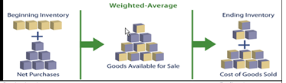
2.) Weighted Average Method
It assigns the average cost of production to a given product, is most commonly employed when inventory items are so intertwined that it becomes difficult to assign a specific cost to an individual unit.
In this method, divide the cost of the goods that are available for sale by the number of those units available in business. This calculation yields the weighted average cost per unit

Slide 27
Practical problem - II
The following is a summary of the receipts and issues of materials in a factory during the month of April.
Prepare a statement showing the pricing of issues on the basis of Weighted Average Method

Slide 28
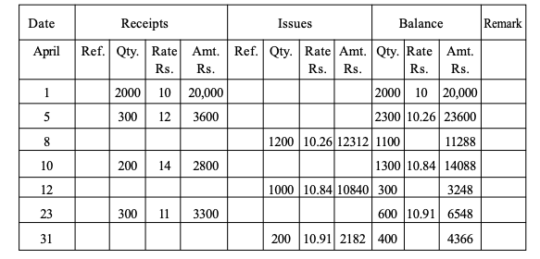
Solution

Slide 29


Inventory Valuation at HUL
Source: HUL Annual Report, 2019 – 20

Slide 30
Suitability of Valuation Methods
Method | Description | When to use
FIFO | In inventory valuation, it is assumed that the first items placed in inventory are sold first. | In business environments where product cost is stable. When prices are rising, the balance sheet shows greater value. This means that tax liabilities increase, but credit scores and the ability to borrow cash improve. For items with a limited shelf life, because the oldest goods need to be sold before they pass their sell-by date.
Weighted Average Method | An item’s unit cost is calculated as the average unit cost at each point in time after a purchase. For inventory valuation, it is assumes that all inventories are sold simultaneously. | In business environments where product cost is unstable. When inventories are piled or mixed together and cannot be differentiated, such as chemicals.

